Slide 1
Introduction 1 zaf
Goals

Slide 2
Design 1 zaf
Use case
Architecture

Slide 3
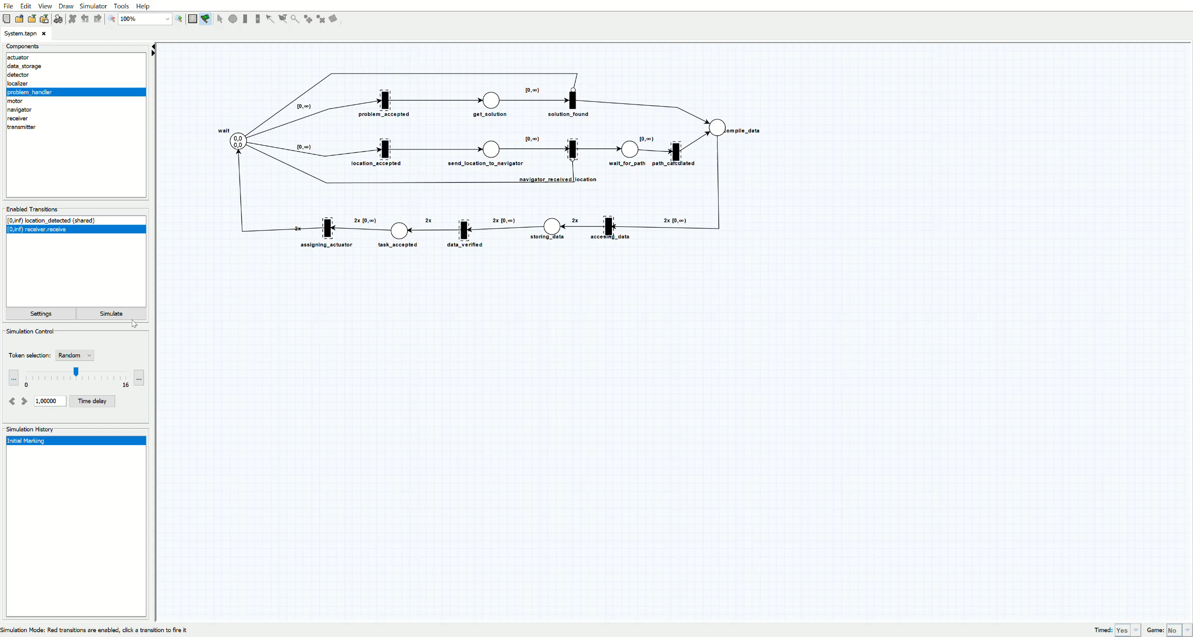
Design (TAPAAL)

Slide 4
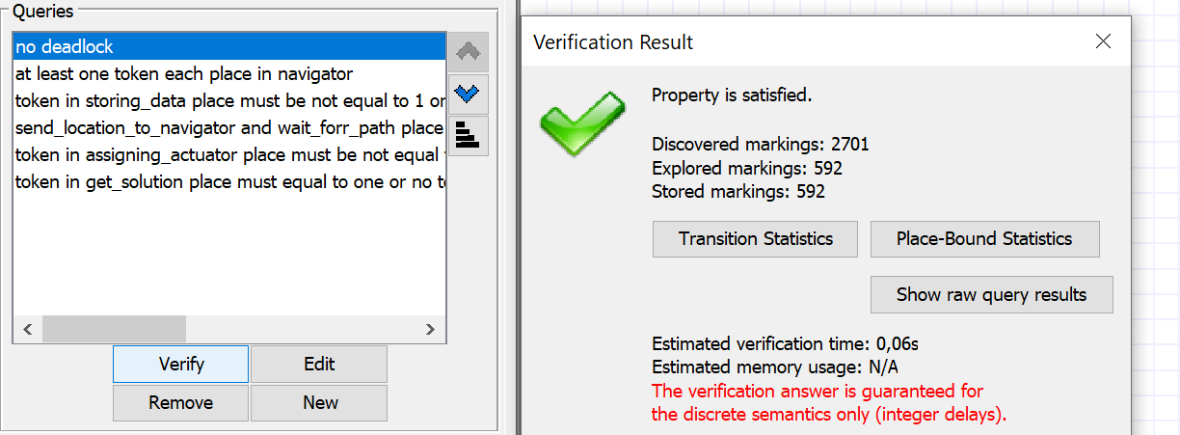
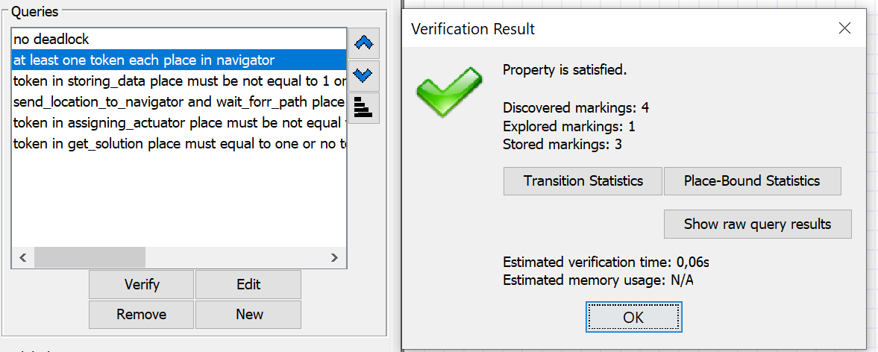
Design (Verification)

Slide 5
Implementation 2 sheikh
Data
Model( include comparison)

Slide 6
Implementation 2 ammar
Create field and drone
Works on field

Slide 7
Evaluation 1 abis
Result on field

Slide 8
Conclusion 1 abis

